Slide 1
REVIEW-3 on INTERACTIVE MAPS FOR LOCAL SERVICES
NAGA SREEJA KODALI – 2410030076
BIJJU ADITHI YADAV – 2410030228
LIKITHA THUMMA – 2410030229
ESHA MANOGNA H – 2410030232
MALREDDY MANOGNA – 2410030430
Under the Guidance of
Dr. A.Siva Krishna Reddy
Associate Professor
Computer Science and Engineering Department
KL Hyderabad Off Campus, Aziz Nagar ,Hyderabad

Slide 2
Overview
Introduction
Objectives of the Project
Literature Review
Proposed Methodology/Architecture/Algorithm/Technique/etc
Design (diagrams)
References

Slide 3
Introduction
In our daily life, we often need quick access to services like hospitals, ATMs, grocery stores, bus stops, and restaurants.
Many times, people struggle to locate these services, especially in new or unfamiliar areas.
Interactive maps provide an easy way to explore and find nearby services on a single platform.
They allow users to see real-time locations, directions, and details of the services.
This project focuses on creating a map that makes it simple to search, filter, and identify local services.
Such a system is useful for citizens, tourists, emergency needs, and even government planning.
The main aim is to improve convenience, save time, and enhance access to essential services.

Slide 4
Objectives of the Project
Develop a user-friendly interactive map for local/community services (schools, hospitals, shops, transport, institutions).
Provide real-time, localized information (opening hours, availability, routes).
Ensure adaptability for different institutions and service domains.
Enable better community engagement by integrating feedback/reviews.
Offer scalability for use across various communities and organizations.

Slide 5
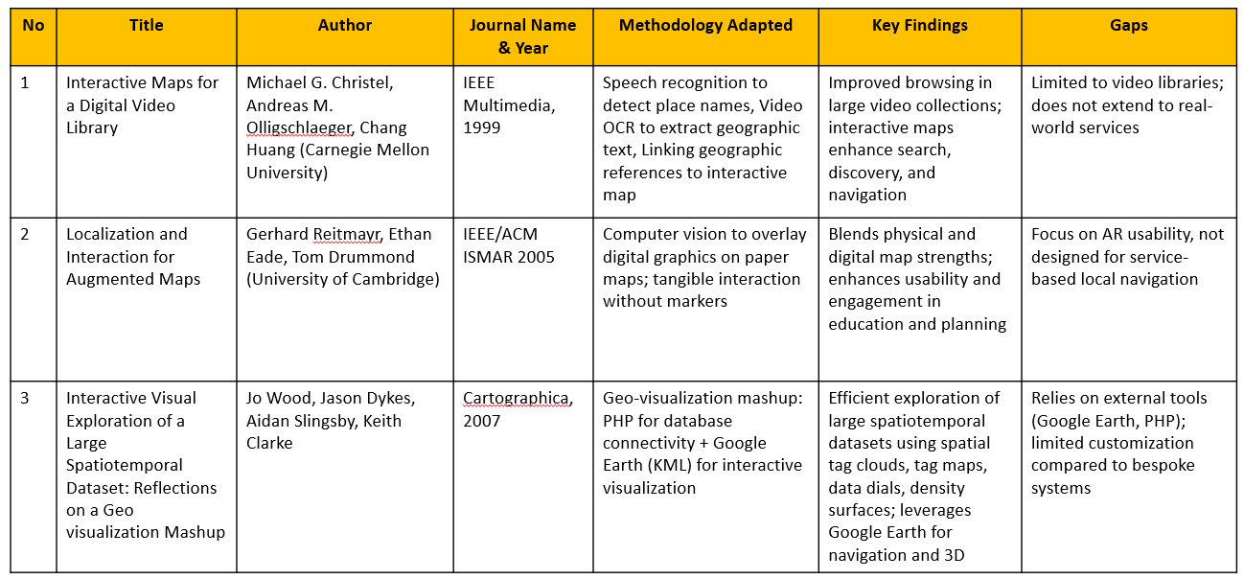
Literature Review

Slide 6
Proposed Methodology
Users select profile and service type.
Services are hardcoded on the map as markers.
Users can search and filter services.
Distance to services is calculated using a random number concept within a 2 km radius.
Map highlights the nearest service(s).

Slide 7
System Architecture
User Interface: HTML, CSS, JavaScript.
Map Library: Leaflet.js.
Local Data: Hardcoded service locations with coordinates.
Distance Calculation: Random numbers simulate distance for nearby services.

Slide 8
Algorithm
User selects profile and service type.
JavaScript checks hardcoded service locations.
Distance is generated randomly within 2 km radius.
Nearest services are highlighted on the map.
Map shows markers with optional directions.

Slide 9
Techniques Used
Frontend only: HTML, CSS, JavaScript.
Map Rendering: Leaflet.js.
Distance Simulation: Random numbers concept (approx. 0.39 factor).
Filtering: Based on user profile and service type.

Slide 10
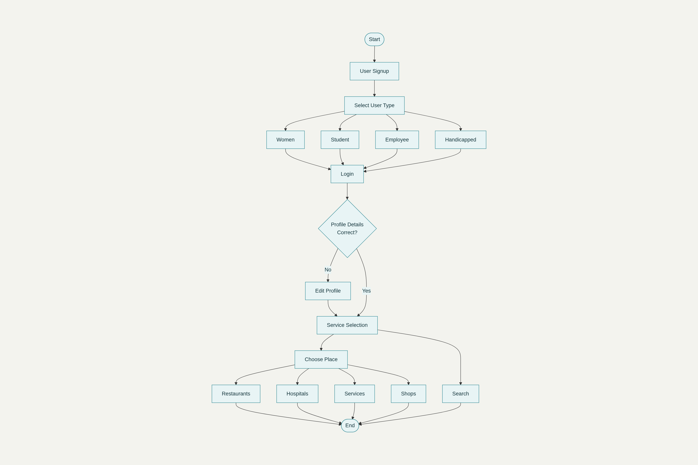
Designs

Slide 11
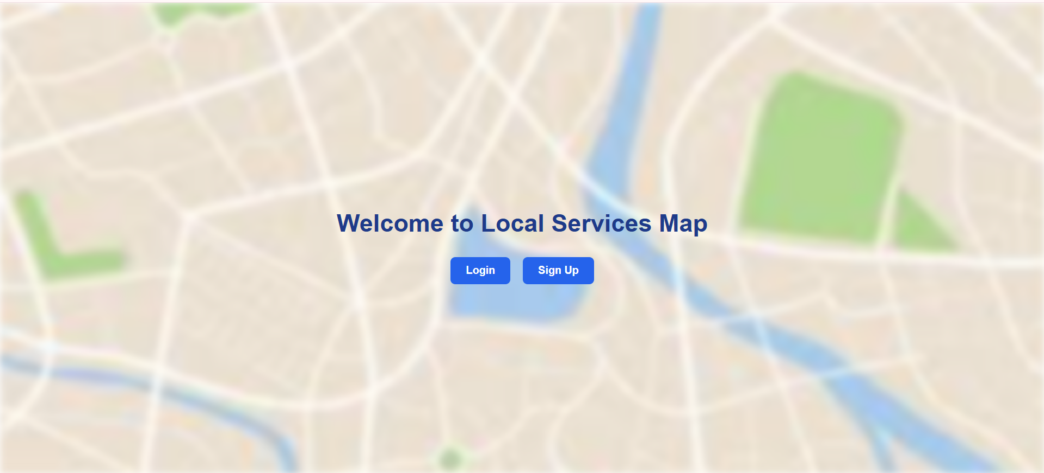
Home Page

Slide 12
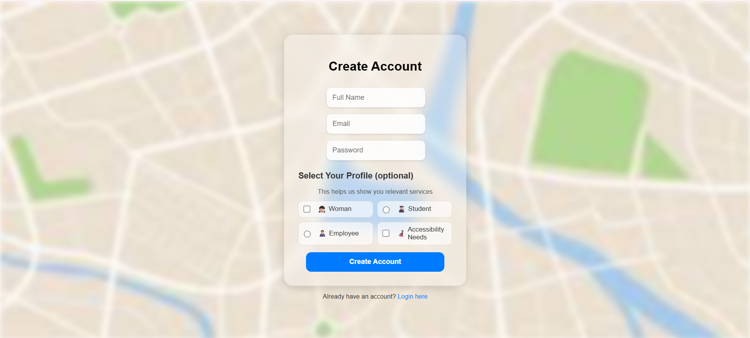
Signup

Slide 13
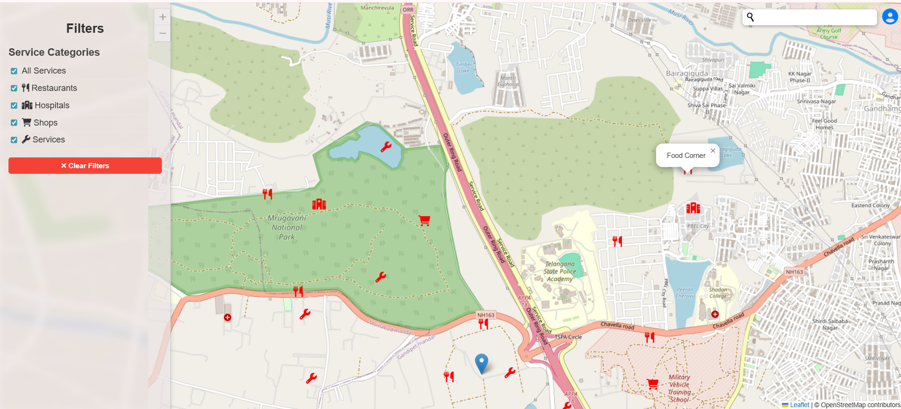
Map

Slide 14
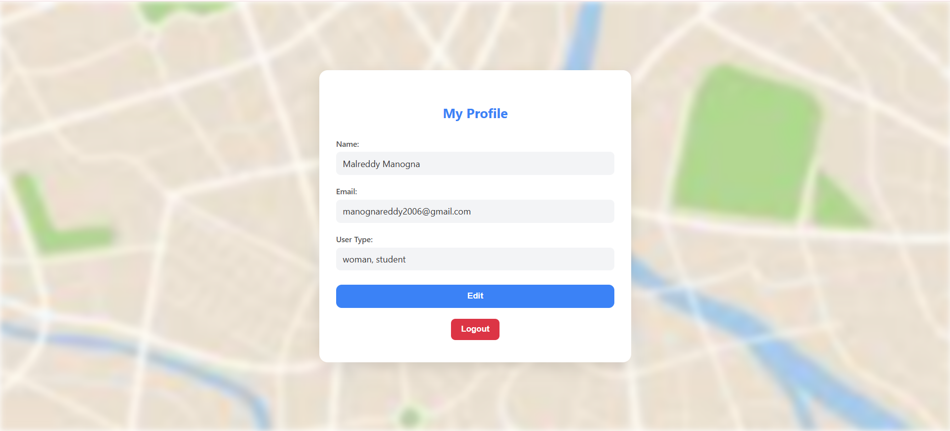
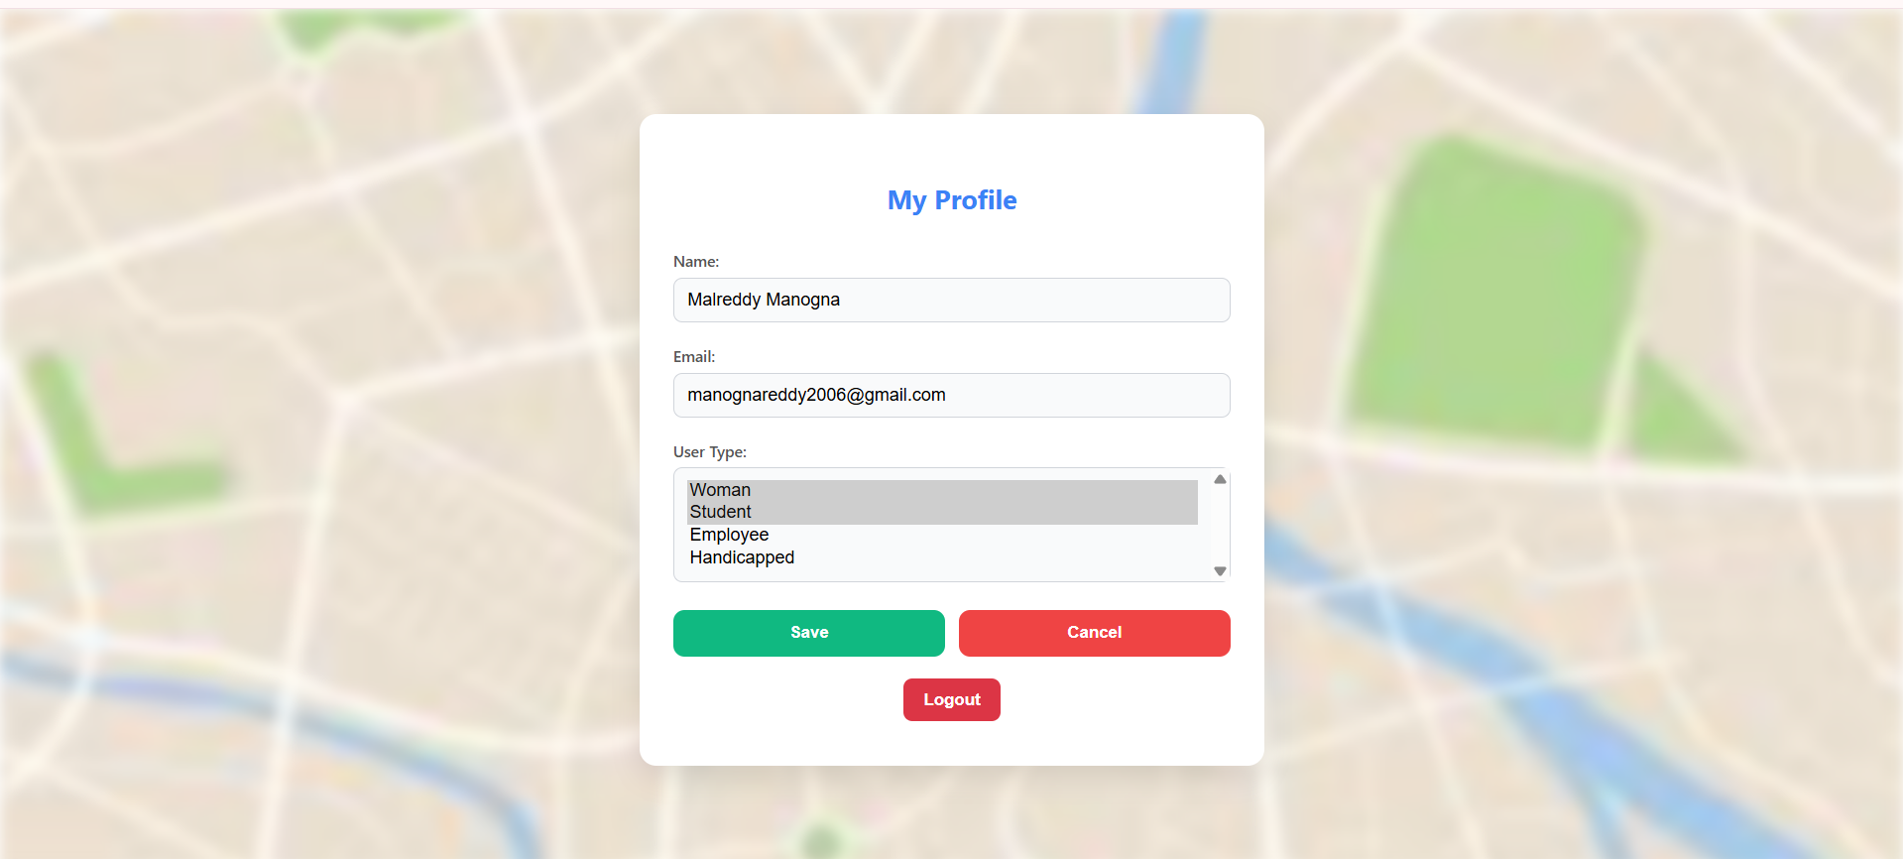

Slide 15
References
https://leafletjs.com/
https://web.archive.org/web/20070610052712id_/http://www.informedia.cs.cmu.edu/documents/interactivemaps_IEEE.pdf
https://www.researchgate.net/profile/Gerhard-Reitmayr/publication/4195912_Localisation_and_interaction_for_augmented_maps/links/0912f50bda5358c975000000/Localisation-and-interaction-for-augmented-maps.pdf
https://openaccess.city.ac.uk/id/eprint/176/2/Interactive%20visual%20exploration%20of%20a%20large%20spatio-temporal%20dataset.pdf

Slide 16
Thank you

